Slide 1
The Effect of Newspaper Entry and Exit on Electoral Politics
By Matthew Gentzkow, Jesse M. Shapiro, and Michael Sinkinson

Slide 2
Introduction: motivation, research question
Method: econometric approach/tools
Interpretation: authors’ explanation of results
Implications: theory, possible policy
1
2
3
4
5
6
7
8
Dataset
Results: tables
Limitations: flaws and critique
Discussion questions

Slide 3
Introduction
Motivation：The opening or closing of newspapers has long been linked to the health of democracy
Backgrounds: What causes entry & exit?
Income
Population
Sometimes political consideration directly (patronage)
How newspapers affect: | Conclusion
political participation | Robust positive effect
party vote shares | No evidence of large effect
incumbency advantage | No clear evidence of positive nor negative effect

Slide 4
Dataset
Panel data, multiple levels
County
State
Year
Sample selection: increases the homogeneity of the sample
Central Independent variables:
Change in #of English-language daily newspapers
Republican newspapers - Democratic newspapers
Income = manufacturing output / capita
Central Dependent Variable:
Turnout = total votes / eligible voters

Slide 5
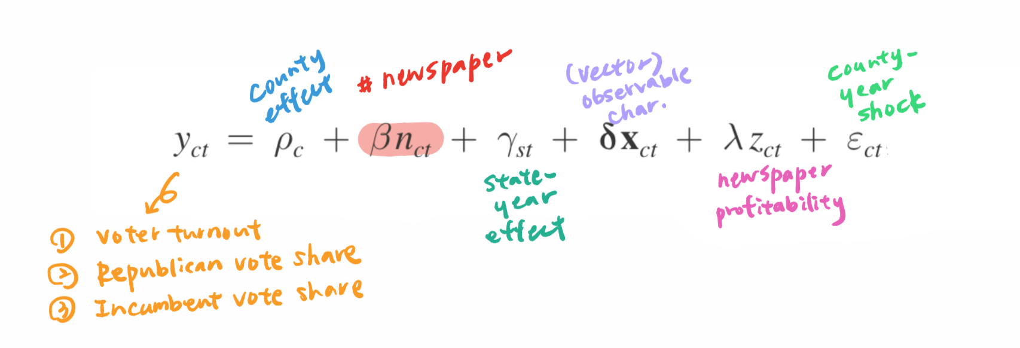
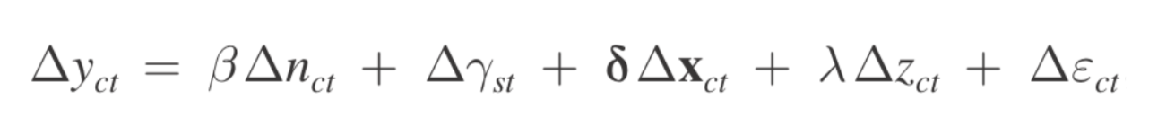
Method
no county effect
Notes:
the vector of controls xct includes changes in the share of the population that is white, the share of the white population that is foreign-born, the share of the population that is 21+-year-old males, the share of the population liv- ing in cities with 25,000+ residents, the share of the population living in towns with 2,500+ residents, the population employed in manufacturing as a share of 21+-year- old males, and the log of manufacturing output per capita (a proxy for income).

Slide 6
Addressing Bias and Causality
E(Δεct |Δγst ,Δxct ,Δzct ,Δnct) = 0
Cov(Δzct , Δnct | Δγst , Δxct) > 0.
If Δnct and past Δγct correlated -> newspaper profitability as a confounder if not -> newspaper entry exert causal effect

Slide 7
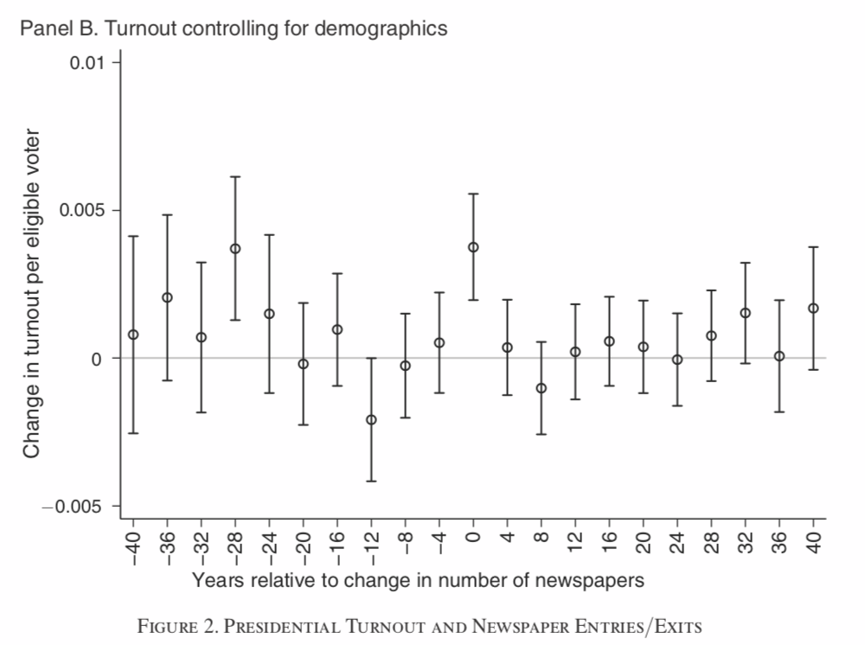
0.34 percentage points increase in voting turnout

Slide 8
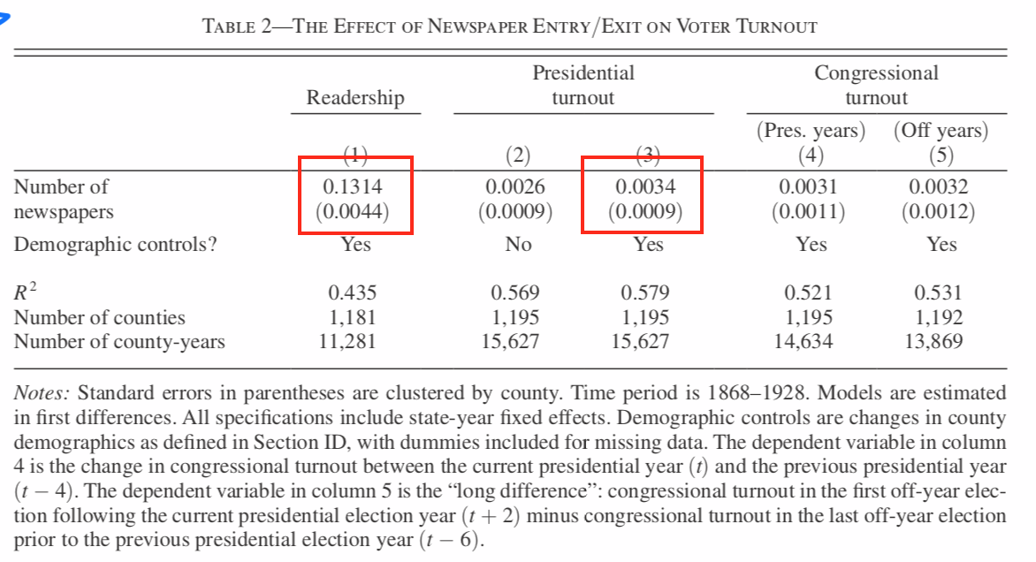
Voter Turnout (Section IV)

Slide 9
Note
Readership as mediator:
Newspaper entry increases readership among eligible voters
Readership results in political participation because of more information input
Second and later entries increase less readership

Slide 10
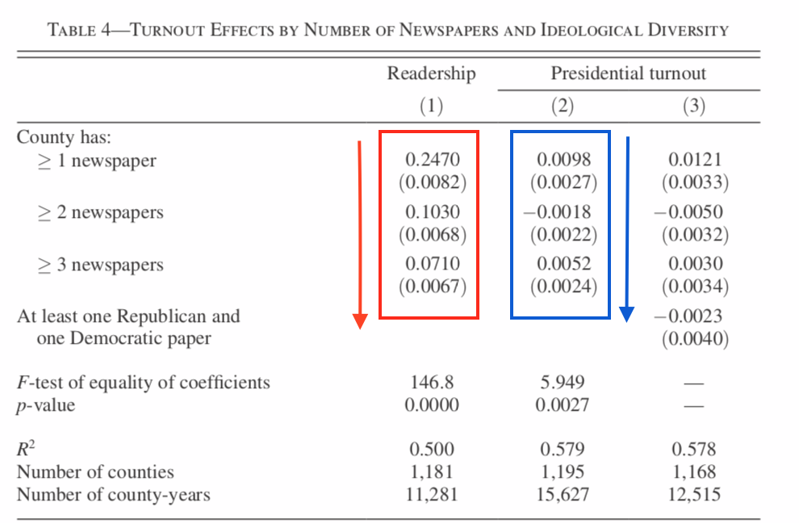
Number of Newspaper

Slide 11
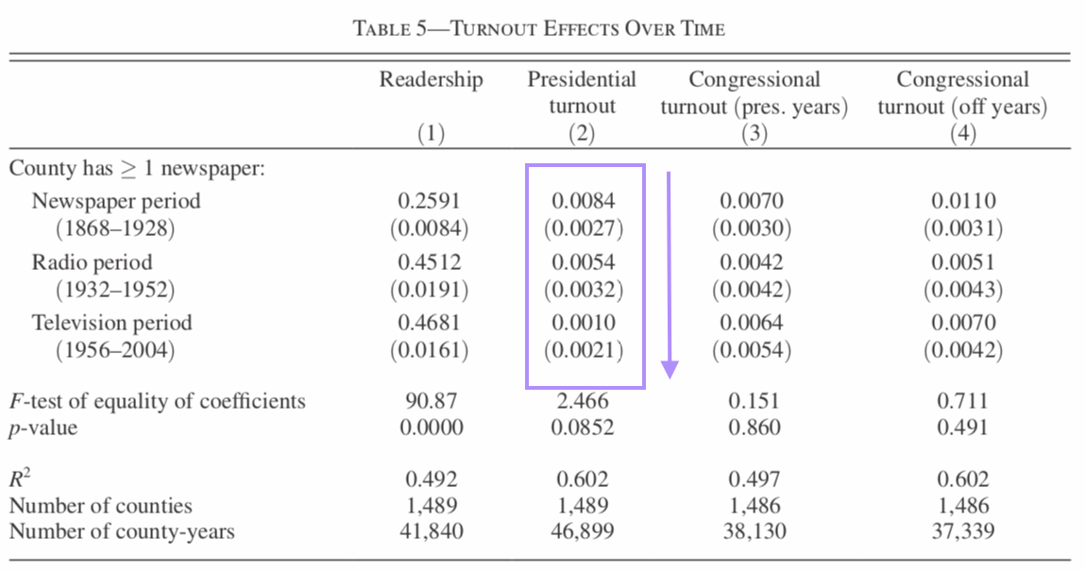
TV & Radio Time

Slide 12
Results
Political Participation
Partisan Vote Share
Incumbency
Sharp increase in turnout during period of entry
First entrant has largest effect
Effect diminishes after introducing radio & TV
No significant effect by newspaper entry on partisan vote share
No clear evidence

Slide 13
Limitations
What are the study’s limitations?
Data - English newspapers
Divided into three periods - newspaper(1872-1928), radio(1932-1952), television(1956-2004)
-newspaper’s values are just providing information?

Slide 14
Implications
Identifying keywords ----> NLP models to determine more features from texts
Measure of Newspaper content ----> Determining influence of modern digital media
Explain political turnouts ----> Education level, public health, consumer preference

Slide 15
Discussion

Slide 16
Question
Why does the study use logarithm to account for voting-eligible population and total votes?
Do you think it is reasonable to divide the data into three time periods? What are the advantages and disadvantages of doing that?
Influence of newspaper on presidential turnout decreases overtime as the emergence of radio and television. Can we conclude that the effect of radios and televisions is causal? Why or why not?
Over the past century, it is a general trend that some counties democratize and develop more rapidly. Is the variation in level of democracy among counties a confounder or mediator? Is it controlled in the study?
The study assigns indicator variables of the number of newspapers in the country. What are the advantages and disadvantages (if any) of having indicator variables instead of a continuous numeric variable?

